Slide 1


International Political Economy
(SOCS-SHU 222)
Monday & Wednesday
12:45 pm – 2:00 pm
Room EB228
Instructor: JING QIAN

Slide 2
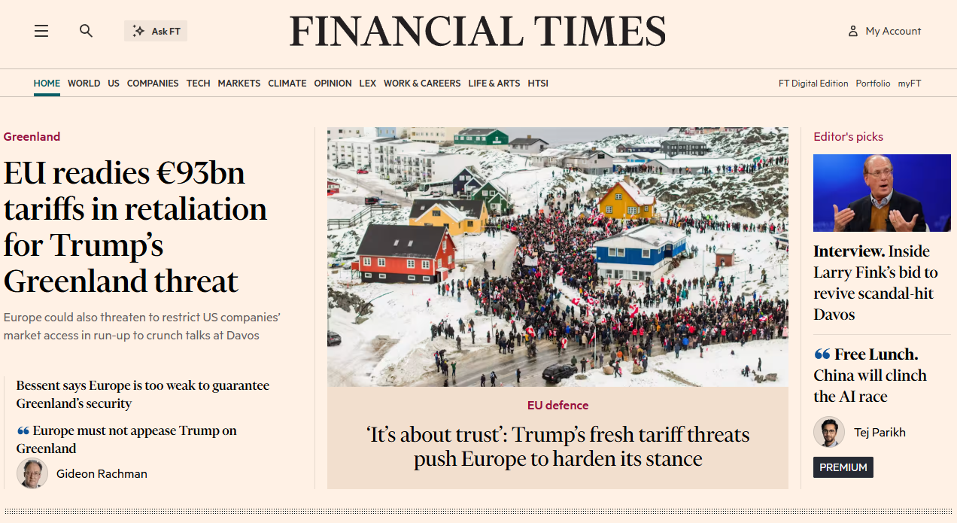

Slide 3
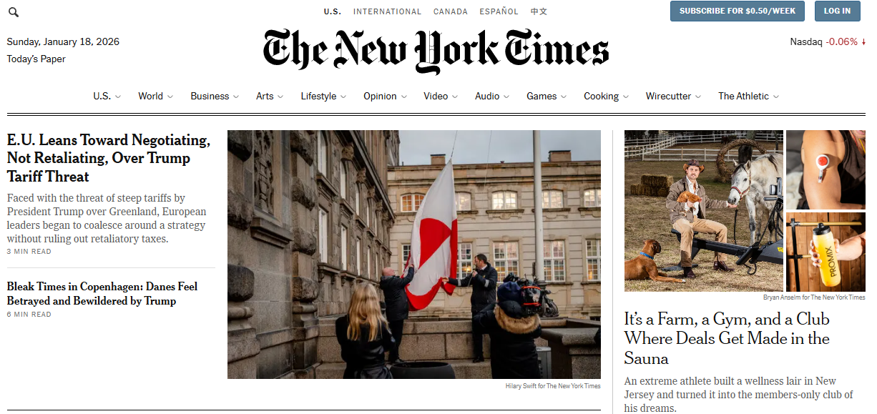

Slide 4
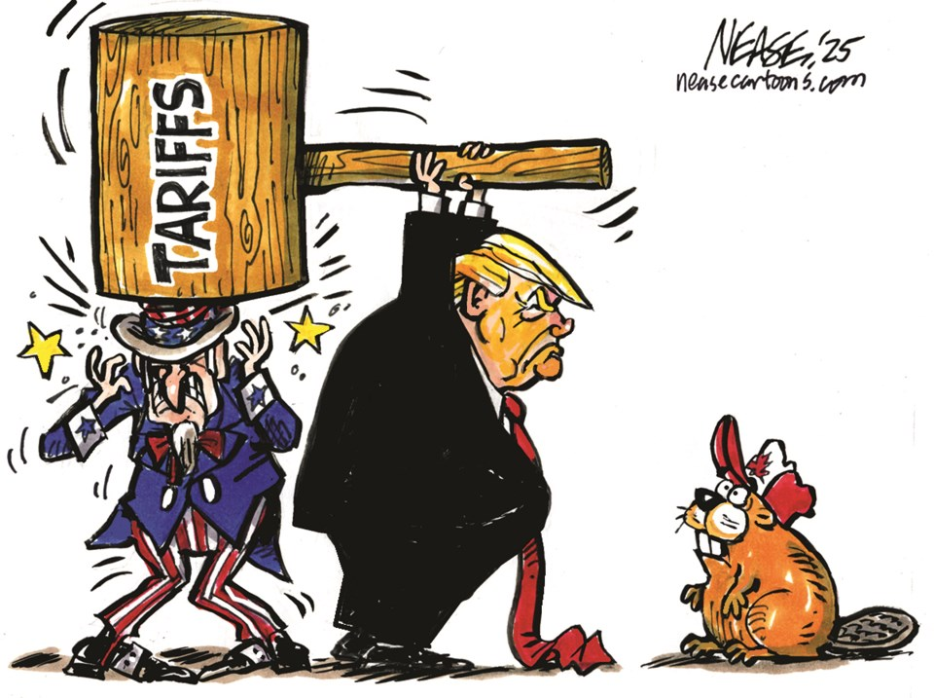
Notes:
https://www.vmcdn.ca/f/files/oakville/images/cartoons/nease-tariff-threat.jpg;w=960

Slide 5
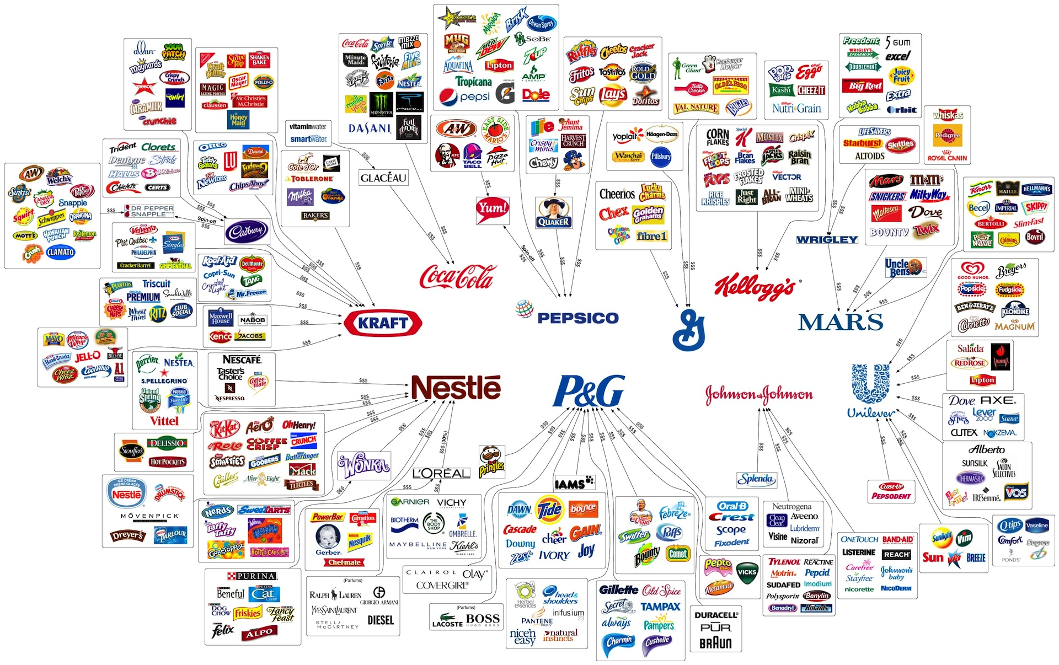
Notes:
https://xeverousphotography.wordpress.com/wp-content/uploads/2013/01/10-multinational-corporations-control-most-consumer-brands1.jpg

Slide 6
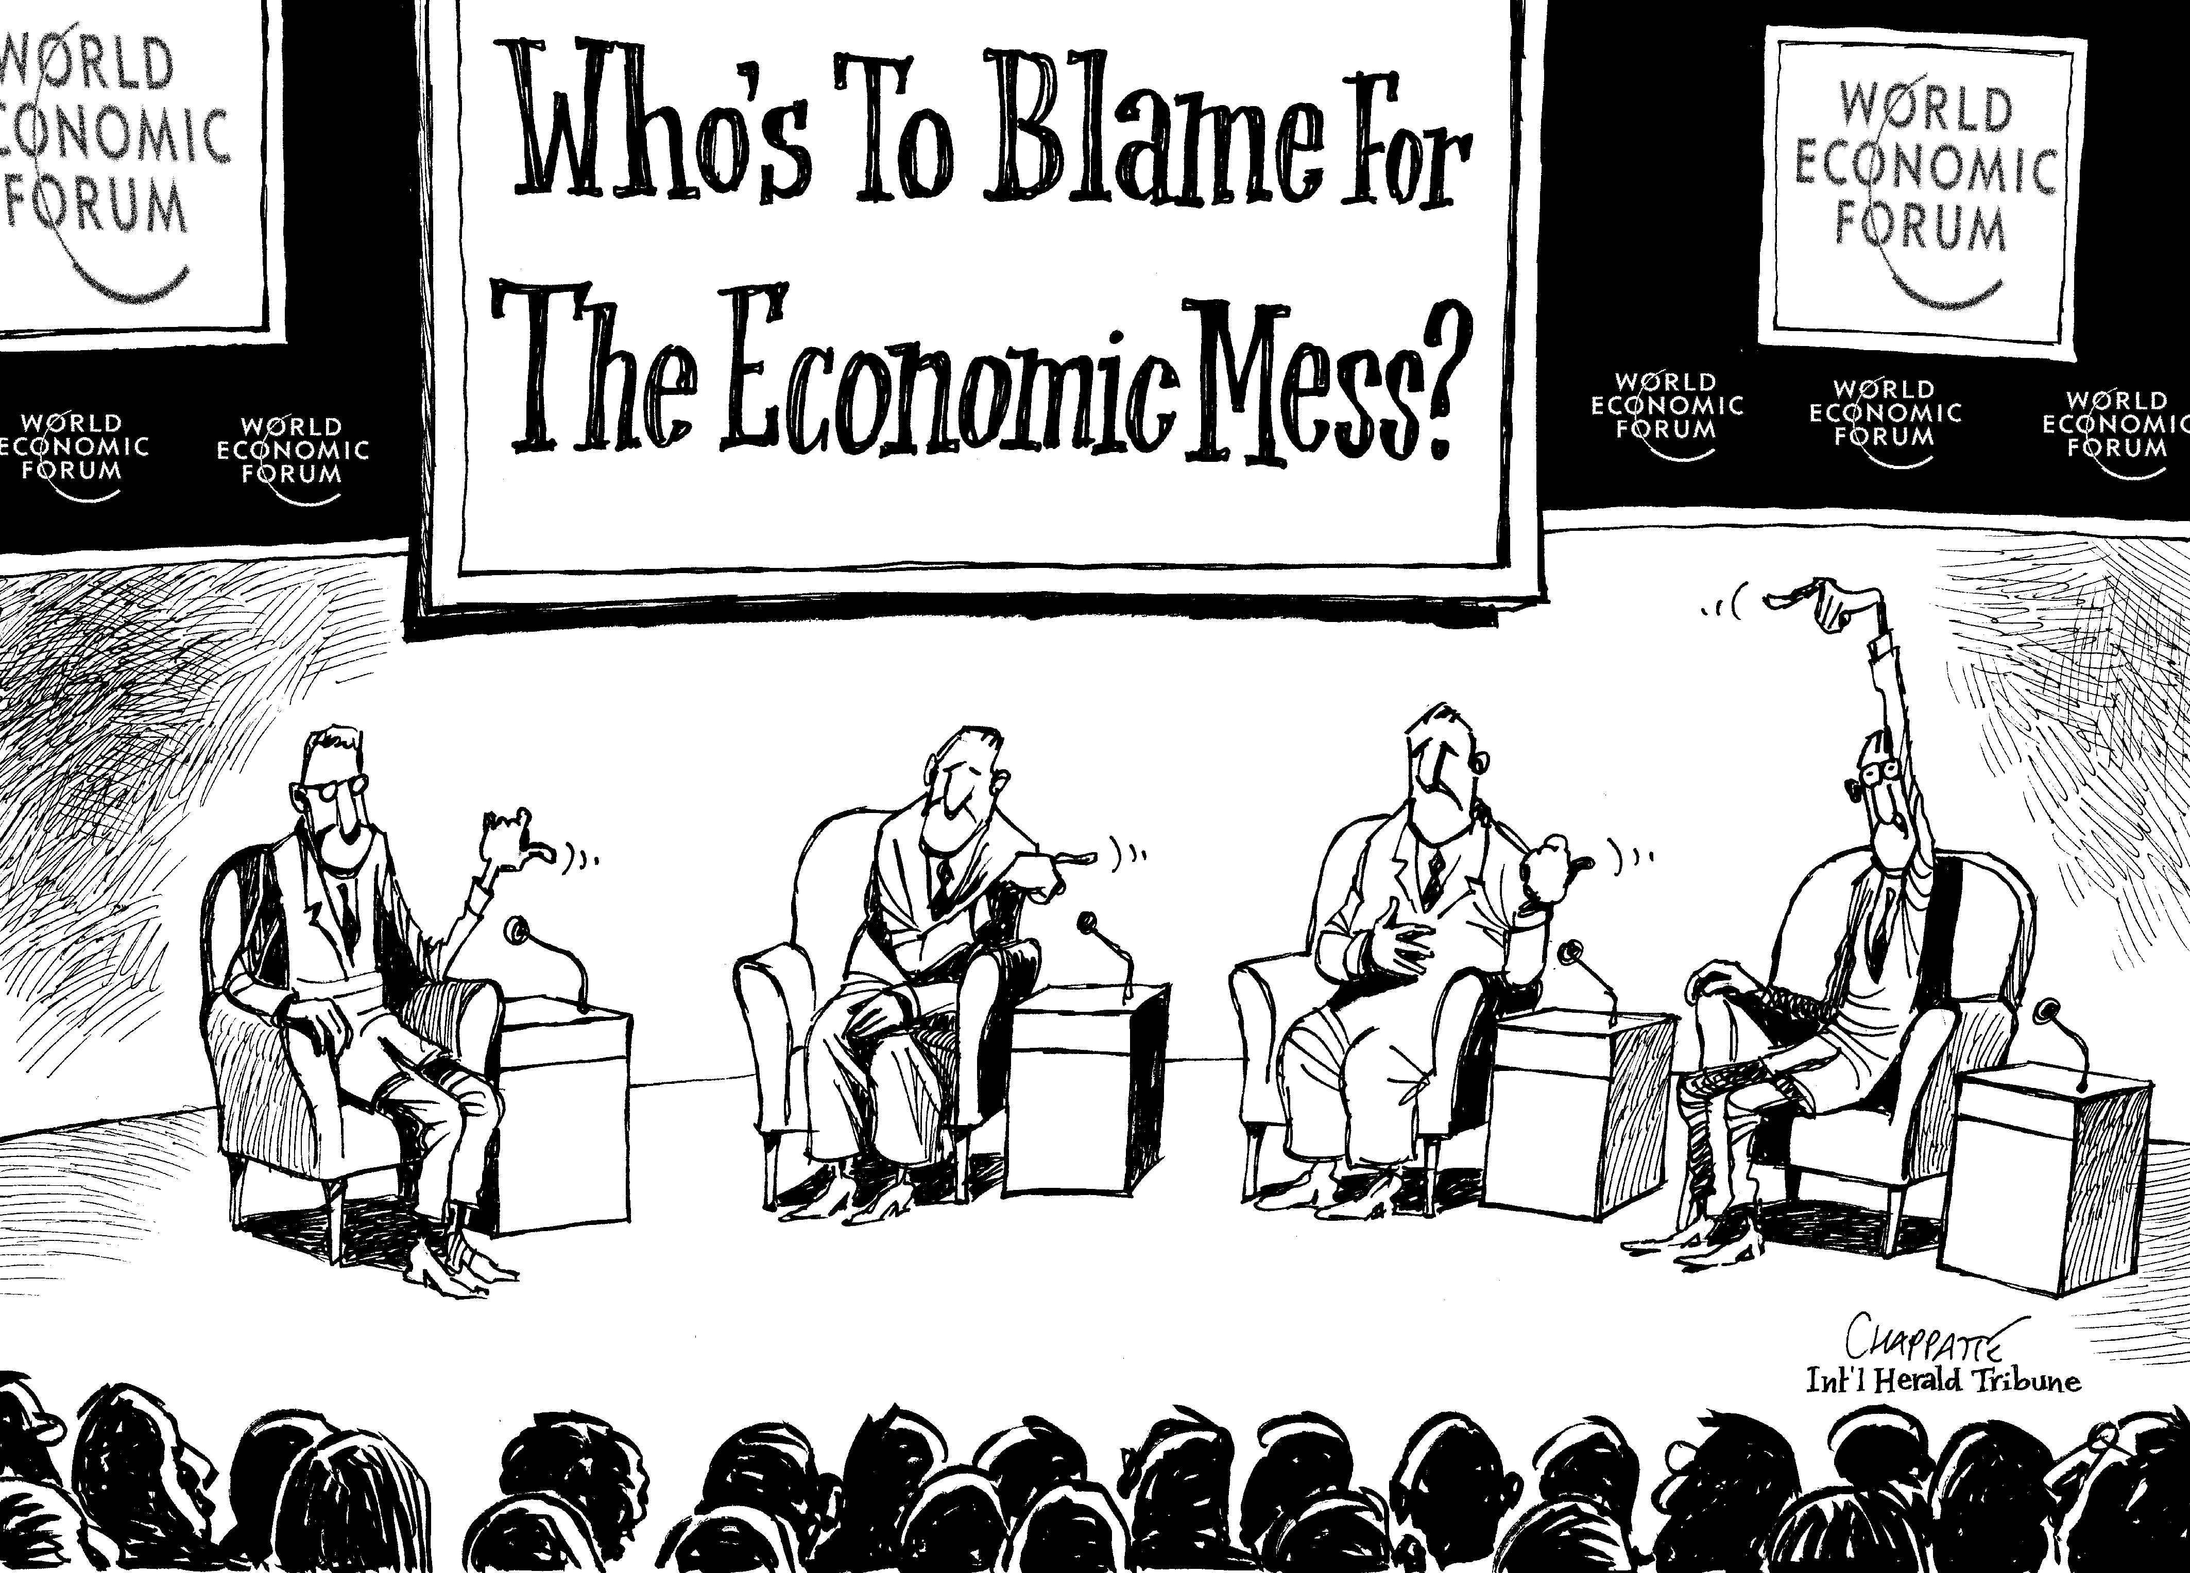
Notes:
https://www.chappatte.com/sites/default/files/styles/original/public/import_ld/I090130.jpg?itok=PyyZSw3v

Slide 7
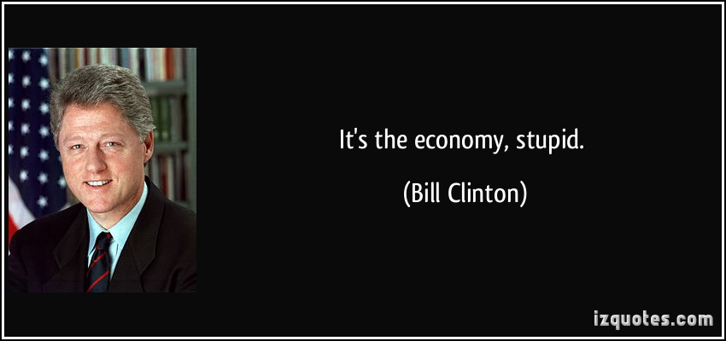

Slide 8
It’s the politics.

Slide 9
Introduction

Slide 10
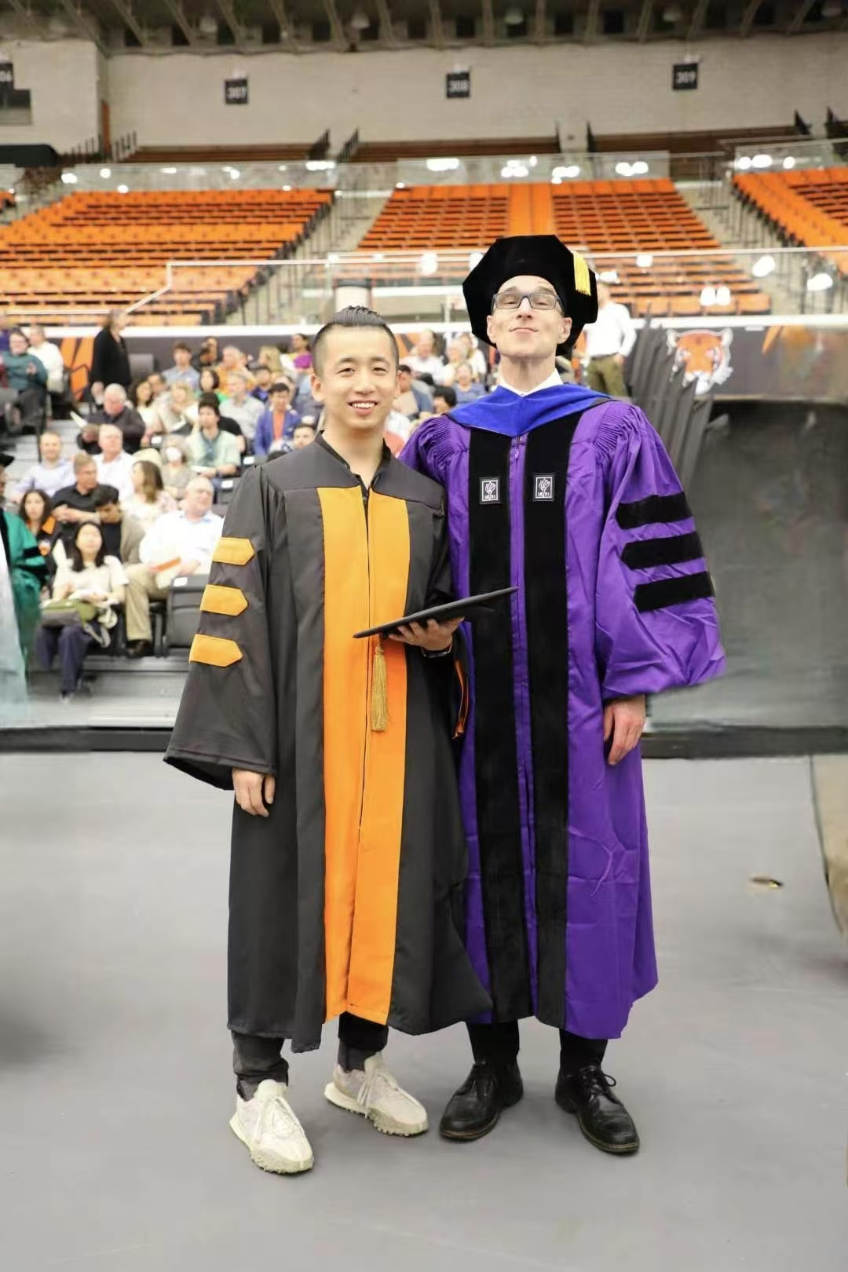





Who is this guy?
Jing Qian
钱璟
Visit https://jingqian.org/ for more

Slide 11

Let’s get to know each other!
(Feel free to share as much or as little as you like)
Name, Preferred Name, Pronouns
Year in School, Major
Where are you from?
Why did you choose this class?
Major/Concentration requirement
Only class fits my schedule
I don’t know either…
Two Truths and a Lie

Slide 12
What is this course about?

Slide 13
I
P
E
nternational
olitical
conomy

Slide 14
I.P.E.
International Political Economy
Economics:
Politics:
International:
distribution of scarce resources
the role of the state in such distribution
flows of such resources across borders

Slide 15
International Flows
Goods & Services (trade)
Finance
People
Pollutants
Others?...
Information, data?
Violence/terrorism?
…

Slide 16
What will we cover in this course?
International Trade and the WTO
Trade Politics and Trade Wars
Trade and Development
Multinational Corporations
International Monetary System
Exchange-Rate Policies
International Finance
Immigration
European Union
China’s Oversea Finance
Digital and Platform Economy

Slide 17
How will this class be taught?
Lectures
Field Trips
Guest Lectures
Movie-watching?
Library Workshop
Suggestions

Slide 18
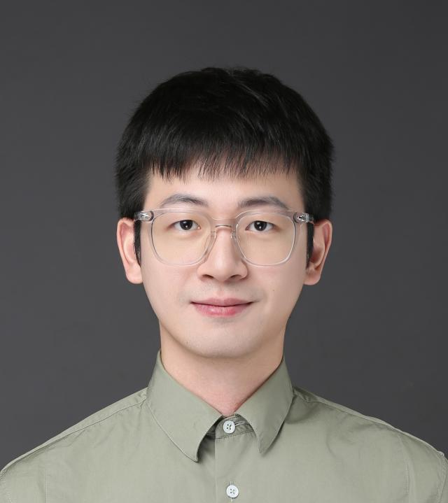
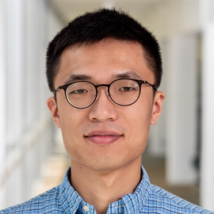
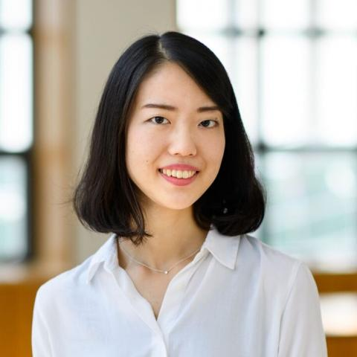
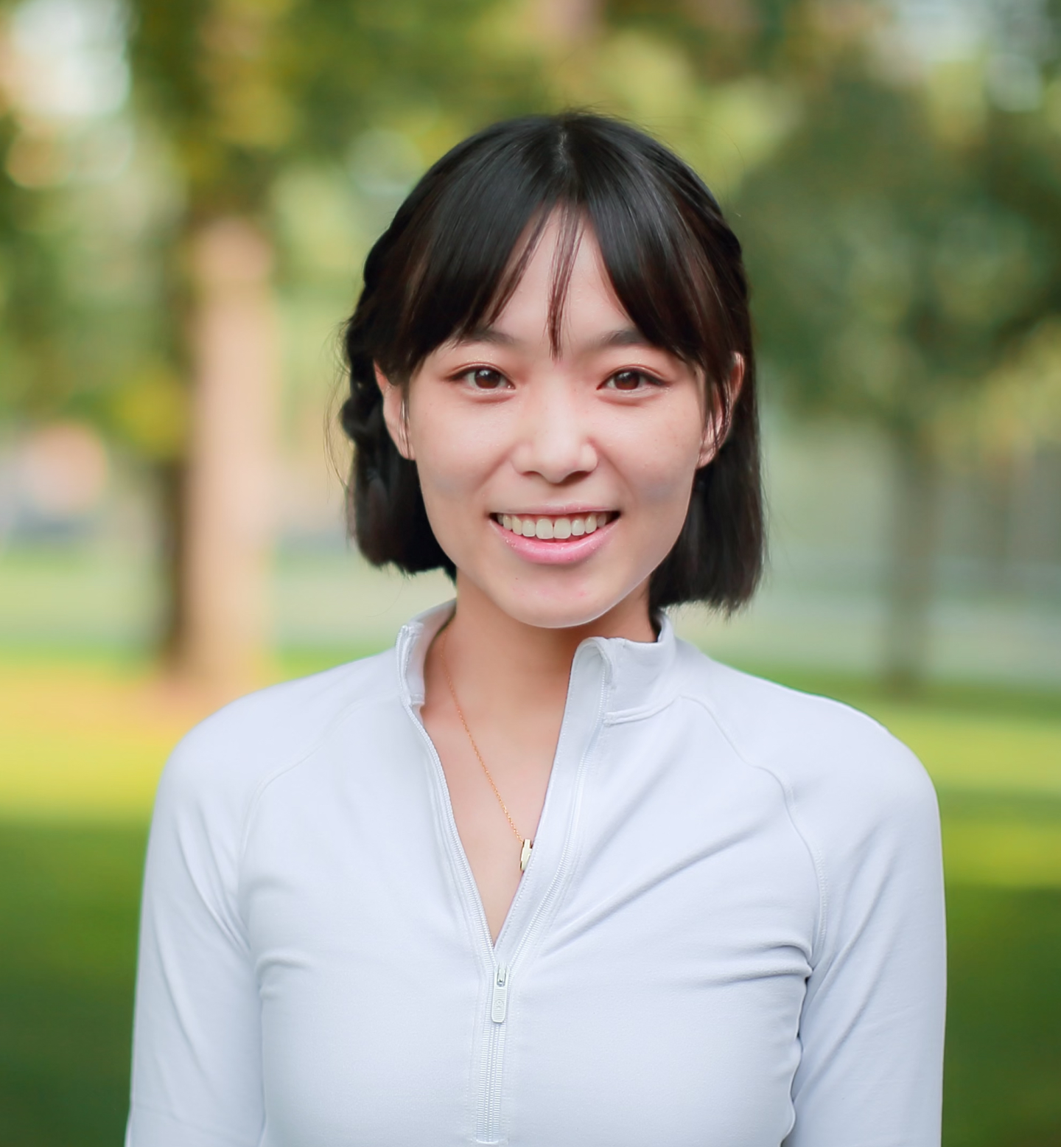
Confirmed Guest Lecturers
(Attendance Required)
February 25
Sifan Xue
National School of Development,
Peking University
March 4
Zeren Li
Lee Kuan Yew School of Public Policy
National University of Singapore
March 16
Sayumi Miyano
Osaka School of International Public Policy
Osaka University
April 22
Chen Xiang
School of International and Public Affairs
Shanghai Jiao Tong University

Slide 19
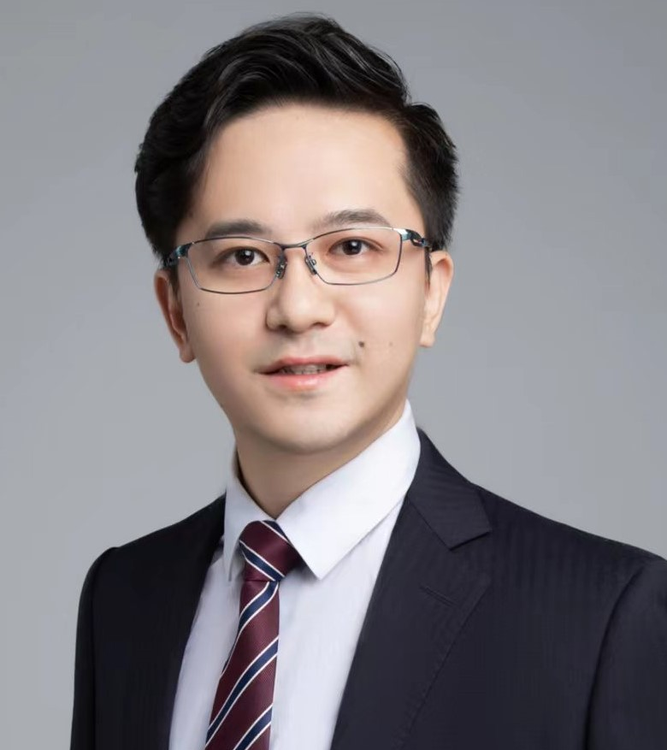
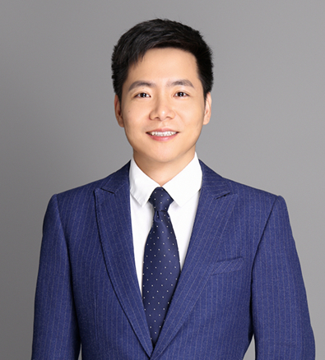
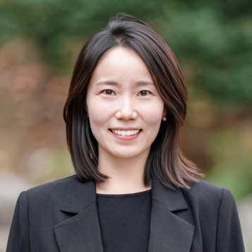
Additional Guest Lecturers
(Attendance Encouraged)
March 11
Jianzi He
Duke Kunshan University
March 30
Jie Huang
Nanjing University
April 29
Jieun Kim
Seoul National University

Slide 20


Confirmed Field Trips
(Attendance Required)
Friday, February 6
2:00 – 4:00 PM
New Development Bank Headquarters
Friday, March 13
4:00 – 5:30 PM
American Chamber of Commerce in Shanghai

Slide 21
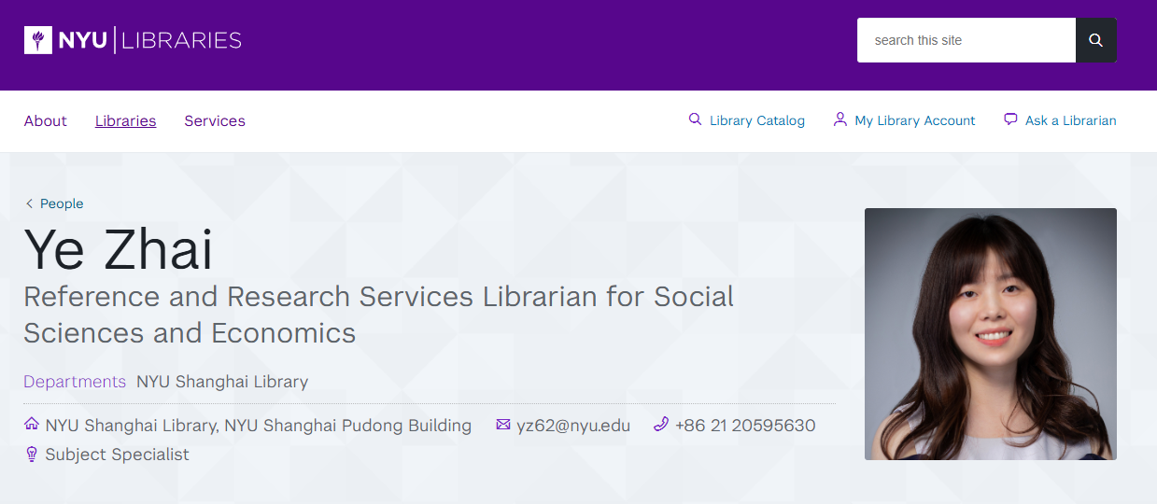
Library Workshop: Wednesday, Jan 28

Slide 22
Note on Guest Lecture and Field Trip Attendance
Guest Lectures
Field Trips
All guest lectures will be scheduled at 3:45 – 5:00PM (Monday or Wednesday) for logistical reasons.
Attendance at guest lectures are required.
Materials from guest lectures will be covered in quizzes.
Zoom recordings are available for approved time conflicts, with a brief note submission.
Attendance at additional guest lectures are encouraged but not required. Extra credits might apply, details TBA.
Attendance at the field trips are required.
Please plan ahead to avoid time conflicts.
Materials from field trips will be covered in quizzes.
Absence from field trips needs instructor approval.
Otherwise, it would be considered as unexcused absence.

Slide 23
What are YOUR
responsibilities in this class?
Go to the syllabus!
jingqian.org/IPEclass

Slide 24

Readings
Readings are relatively light
Avg. 50~60 pages per week
Supplementary readings might be posted for some weeks for your reference
Suggestions and recommendations welcome
Make sure you complete the reading PRIOR to class

Slide 25

Participation!
Participation accounts for 15% of total grade
Ask questions
Respond to peers’ thoughts
Discuss with classmates

Slide 26
Office Hour
Wednesdays, 10:00am – 12:00 pm
Room N851
Sign-up at: https://jingqian.org/officehour
AND by appointment
Additional office hours available ahead of quizzes

Slide 27
Course Assignments

Slide 28
Course Assignments
Weekly multiple-choice questions and answers
News report analysis
AIIB mini case study
Mid-term and (not-cumulative) final Quizzes

Slide 29
Weekly Multiple-Choice Questions & Answers
Week 3 – 13, 10% in total, 1% each week
Submission = Getting Point
Four multiple-choice questions and answers (two per class)
One on the reading(s)
The other on the analytical tool
For each question:
Create FIVE options
Mark the RIGHT choice
Due every Friday 11:59pm on Brightspace (for the classes on that Mon & Wed)
First missed submission excused
Build your own study guide for the exam (together)

Slide 30
News Report Analysis
5% or 10% (Your Choice)
Steps:
Choose a relevant news report from a credible source
Study the issue, related concepts, broader context, and implications
Prepare and submit slides and/or handouts
5-minute in-class presentation followed by 3-minute discussion

Slide 31
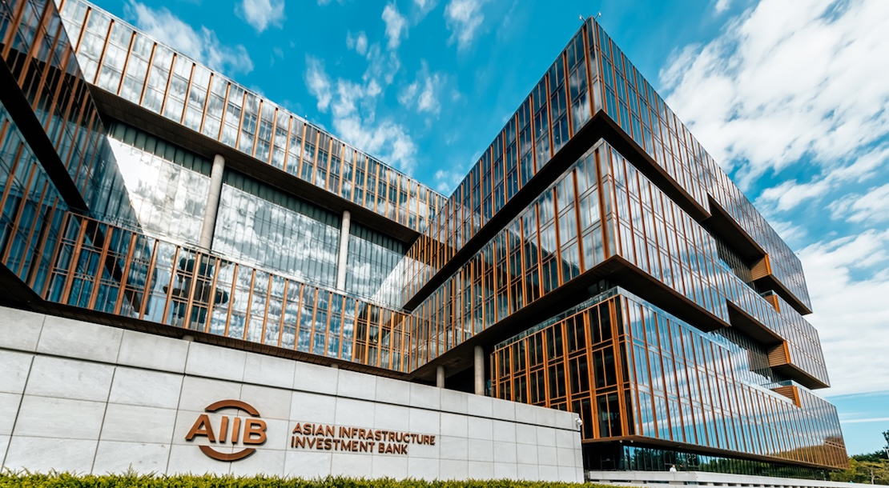
AIIB Mini Case Study
5% or 10% (Your Choice)
Steps:
Select a project from the AIIB website
Conduct a mini case study building on guiding questions (see syllabus)
Submission at the end of your chosen half-semester

Slide 32
Sign-Up Procedure
Steps:
Assignment selection by half-semester (news report analysis or AIIB mini case study).
Weight allocation: 5% or 10%, with 15% combined.
Presentation date preferences (details to follow).
Mini case study report due at the end of the selected half-semester.
(11:59 PM on March 22 OR 11:59PM on May 3)
Complete sign-up by Sunday, January 25 at 8pm. Assignment results will be announced during class on January 26.

Slide 33
Sign-Up Procedure
Why all the troubles?
No First-Come, First-Serve Pressure
Flexibility & Fairness
Balanced Distribution
Learning Through Practice

Slide 34
Sign-Up Procedure: Example
Say you want to:
Do mini case study in the 1st half-semester
News Report Analysis in the 2nd half-semester
Have the News Report Analysis account for 5% of your total grade
Due 11:59PM on March 22
Material due 11:59PM the day before the presentation
Mini case study will account for 10% of your total grade

Slide 35
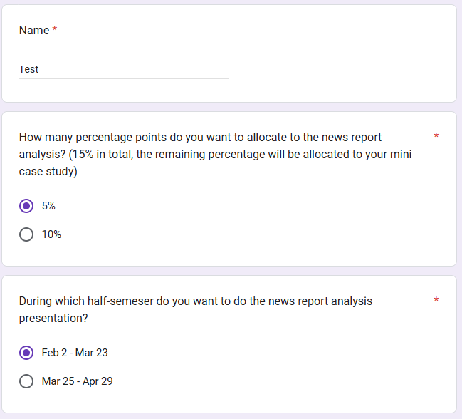
Sign-Up Procedure: Example

Slide 36
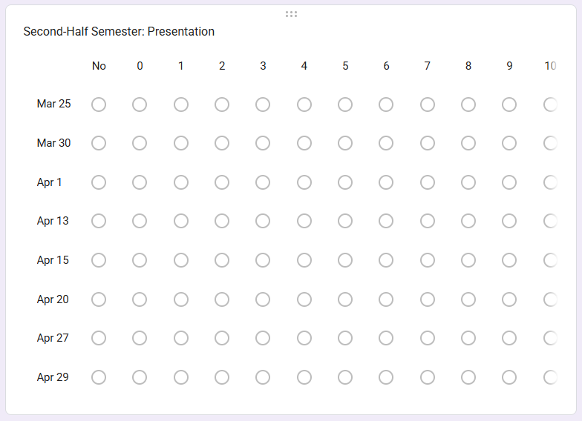
Sign-Up Procedure: Example

Slide 37
Sign-Up Procedure: Example
You will make EXACTLY THREE CHOICEs
One "No": Select the class date you absolutely cannot do by choosing "No."
Two Preferred Dates: For the other two dates, assign weights (from 0 to 10) based on your preference. The total weights must add up to 10 between these two dates.

Slide 38
Sign-Up Procedure: Example
You will make EXACTLY THREE CHOICEs
One "No": Say you absolutely cannot do April 13.
Two Preferred Dates:
You really want to do April 1
Otherwise, March 30 is also fine

Slide 39
Sign-Up Procedure: WRONG Example
More than one ruled-out date
More than two preferred dates

Slide 40
Sign-Up Procedure: WRONG Example
Total weights for preferred dates exceed 10

Slide 41
Quizzes
Take-home, administered on Brightspace
Second Quiz is NOT cumulative
Quizzes will be straightforward
You choose when to take the exams
Quiz window ≈ 4 days
First Quiz: Week8
Second Quiz: Exam week
And how much each quiz accounts for
The two quizzes account for 60% of the final grade
Each quiz can count for 20% - 40% of the final grade

Slide 42
Quizzes
What’s the point?
CREDIBLE COMMITMENT
Designed to help you to do your work
Emphasizes a key point of the class:
The Importance of Incentives
Why choosing your own weight?
PRIORITIES
Commitment and Ownership

Slide 43
Your Choice
Assignments/Activities | % of Final Grade
Class Participation | 15%
News Report Analysis | 5% or 10%
AIIB Mini Case Study | 5% or 10%
Weekly Multiple-Choice Questions and Answers | 10%
First Quiz | 20% - 40%
Second Quiz | 20% - 40%

Slide 44
Class Policies

Slide 45
No Late Assignment & No Re-grading
No Late Assignment
Multiple-choice: Grade by submission
News Report: Sign-up & switch
Exams: Take-home & flexible

Slide 46
Attendance
First absence – No excuse needed
Second absence – Reasonable explanation
Third absence – Let’s chat
Exceptions apply
Advance notice required/encouraged
Everyone is crucial for this small class

Slide 47










Technology in the classroom
Bottomline: Respectful Use

Slide 48
Food & Drink
12:45PM – 2:00PM isn’t the best class time
Especially if you have class right before
Food & drink are permitted
Exclusions:
Loud noise
Strong smell
Bottomline: Do not disturb the classroom

Slide 49


GenAI policy
Overall Policy
Embrace, Not Forbid
Enhance, Not Replace
Ethics & Integrity

Slide 50
GenAI policy
Allowed Use
Language checks
Initial thoughts (must revise)
Brainstorm
Etc.
Prohibited Use
Direct submission of AI-generated contents
Sentences, paragraphs, essays, etc.
Bottomline:
Acknowledge any use of GenAI
Open discussion of helpful application
It's nearly impossible to detect with certainty, so I choose to place my trust in each of you.

Slide 51
Questions, please

Slide 52

Thank You!

